Slide 1
Data Structures

Slide 2
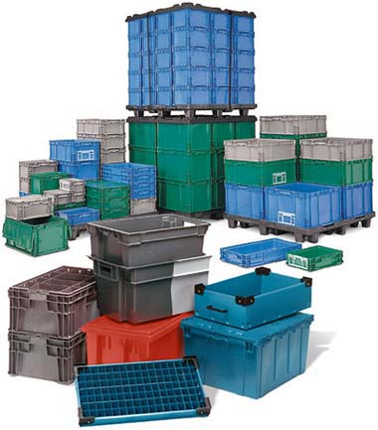
what is data structure?
A data structure is a particular way of organizing data in a computer so that it can be used efficiently.
A data structure is a scheme for organizing data in the memory of a computer.
Data structure is a type with implementation.

Slide 3
Characteristics of Data Structures
Data Structure | Advantage | Disadvantage
Array | Quick insertion, very fast access if index known. | Slow search, slow deletion, fixed size, Static memory.
Stack | Provides last-in, first-out access. | Slow access to other items.
Queue | Provides first-in, first-out access. | Slow access to other items.
Linked list | Quick insertion, quick deletion. | Slow search.
tree | Quick search, insertion, deletion (if tree remains balanced). | Deletion algorithm is complex.
Graphs | Searching, simulatation of real world | Insert, deletion, travelling
Notes:
http://www.idevelopment.info/data/Programming/data_structures/overview/Data_Structures_Algorithms_Introduction.shtml
http://xlinux.nist.gov/dads//

Slide 4
Types of Data Structures
STATIC DATA STRUCTURE
The size of the structure is fixed.
Good for storing a well-defined number of data items.
DYNAMIC DATA STRUCTURE
The size of the structure is variable.
Is allowed to grow and shrink as demand.

Slide 5
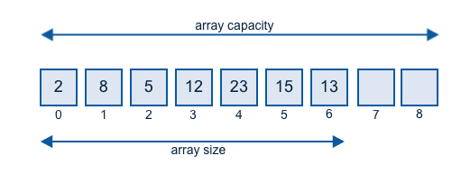
Array
Arrays are used to store collection of variables of same data type.
Arrays are fixed length(static data structure)
is a group of similar typed variables that are referred to by a common name.
Operations : Add, delete, insert, sort, search

Slide 6
Stack
Stack is a Last-in First-out scheme data structure.
Insertions and deletions follow the last-in first-out scheme
push(object): inserts an element
object pop(): removes the last inserted element
object top(): returns the last inserted element without removing it
integer size(): returns the number of elements stored
boolean isEmpty(): indicates whether no elements are stored

Slide 7
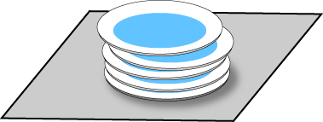
Example

Slide 8
Queue
Queue is a First-in First-out scheme data structure.
Insertions and deletions follow the First-in first-out scheme
boolean isEmpty(): checks queue is empty?
object getFront(): returns front element
object dequeue(): remove front element
void enqueue(object): insert an element at the end of queue

Slide 9

Example

Slide 10
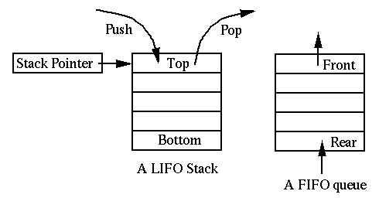
Cont..

Slide 11
Linked list
A linked list is a collection of objects linked together by references from one object to another object.
The basic linked list is a collection of nodes where each node contains one or more data fields AND a reference to the next node
Traversing a linked list.
Append a new node (to the end) of a list
Prepend a new node (to the beginning) of the list
Inserting a new node to a specific position on the list
Deleting a node from the list
Updating a node in the list

Slide 12
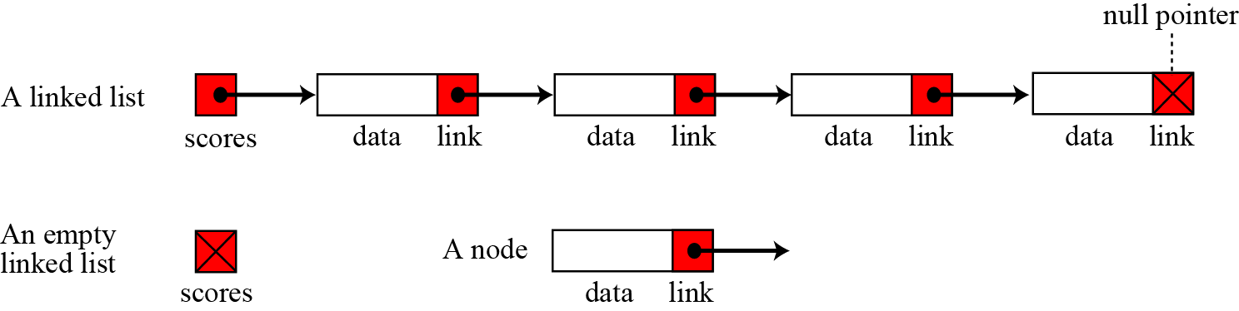
Example

Slide 13
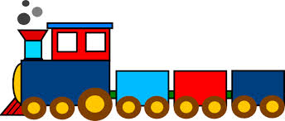
Example

Slide 14
Insert a Node in LinkedList
Inserting into an empty list.
Insertion at the beginning of the list.
Insertion at the end of the list.
Insertion in the middle of the list.

Slide 15
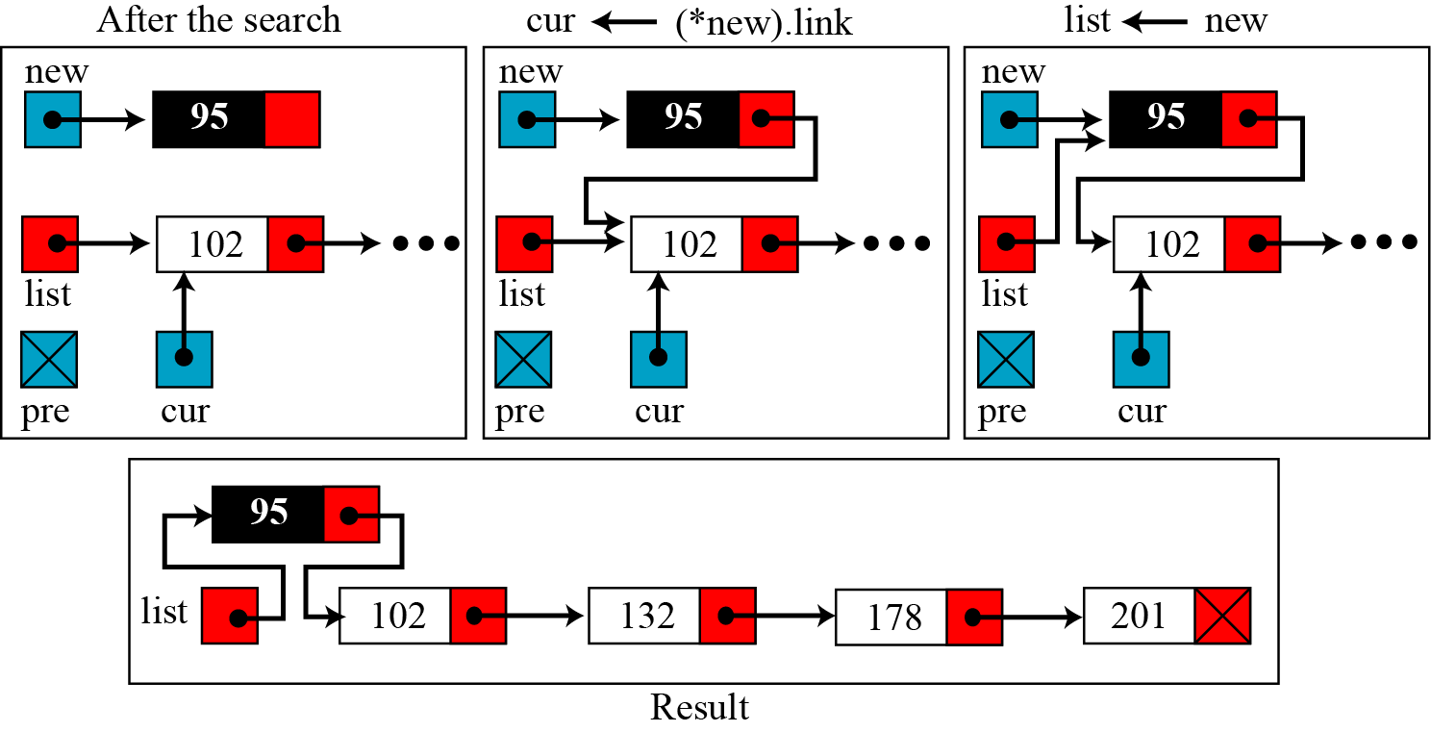
Insert a Node in Linked List at beginning

Slide 16
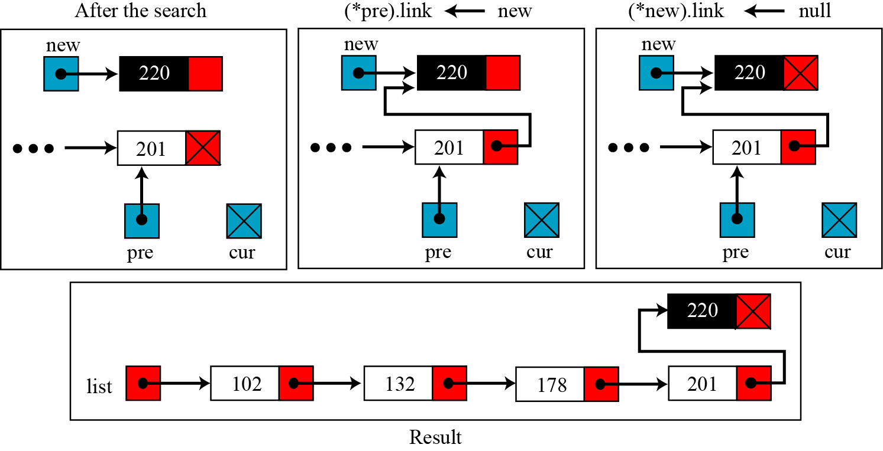
Insert a Node in Linked List at end

Slide 17
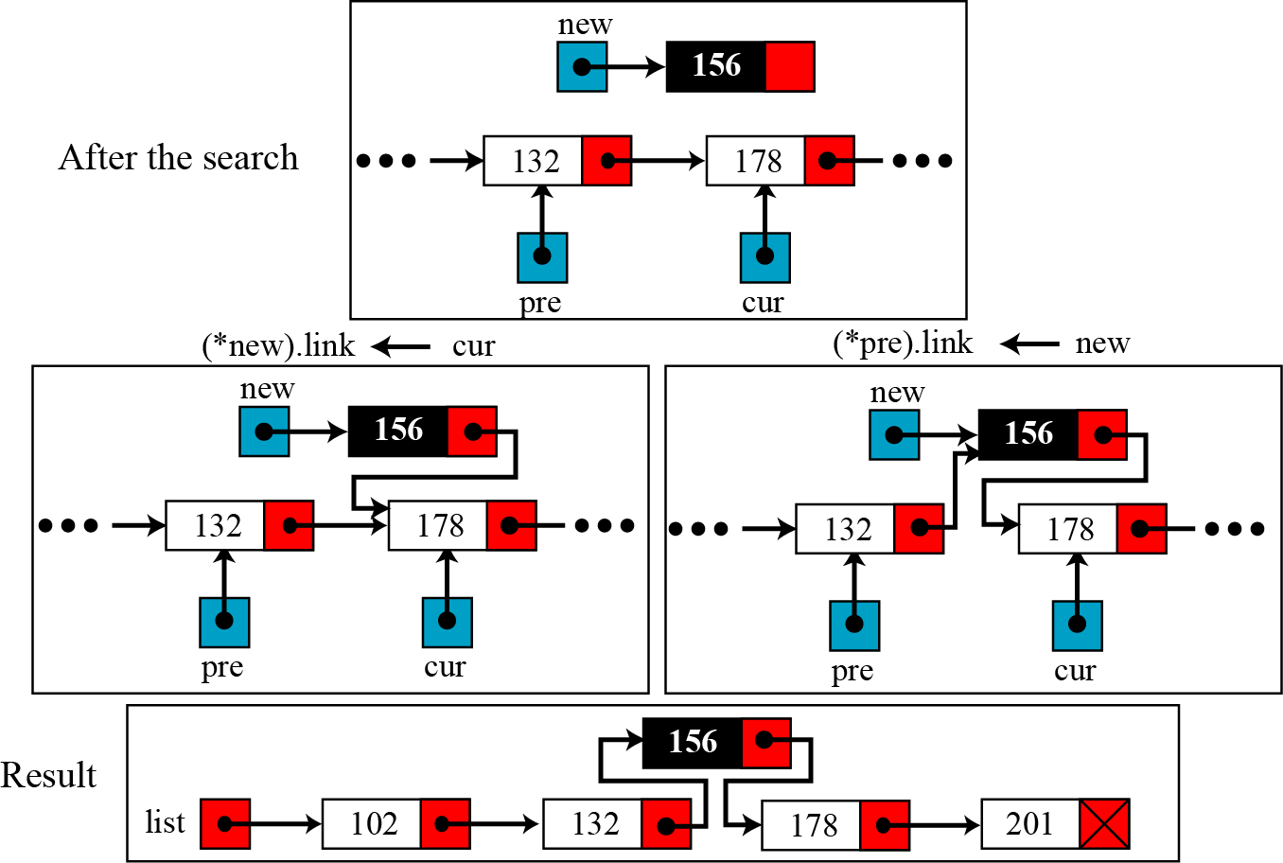
Insert a Node in Linked List in the middle

Slide 18
Deleting a Node in LinkedList
Deleting the first node of a linked list
Deleting a node in the middle of a linked list
Deleting a node at end of a linked list.

Slide 19
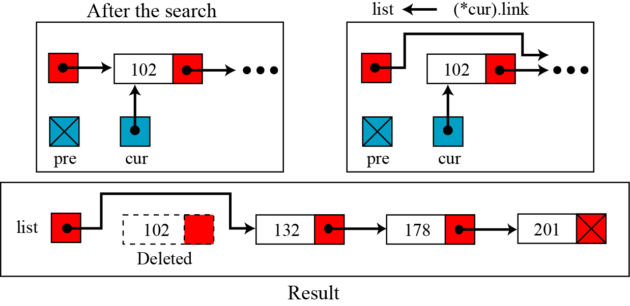
Deleting first node in Linked List

Slide 20
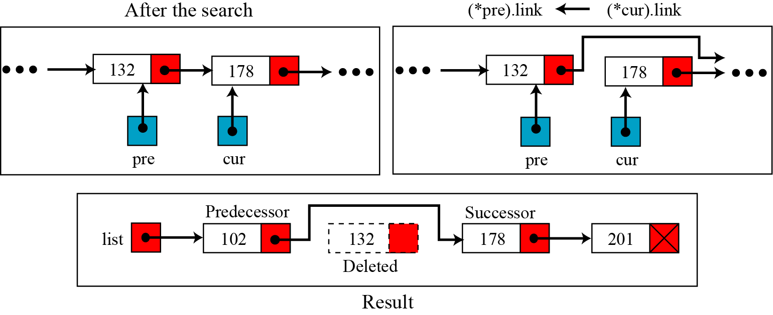
Deleting a Node in Linked List in middle

Slide 21
Tree
Non-linear data structure.
Hierarchical data structure.
Top element root.
Except root element each element has parent.
a set of nodes storing elements such that the nodes have a parent-child relationship.

Slide 22
Tree
Binary Tree
B-Tree/B+ Tree
Red-Black Tree
Zig-Zag Tree
Traversing a tree
In-order(left -> root -> right)
Pre-order(root -> left -> right)
Post-order(left -> right -> root)

Slide 23
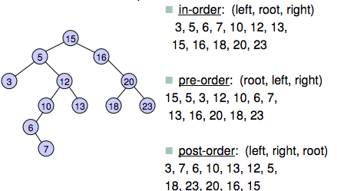
Example

Slide 24
B-Tree
A B-tree of order m is an m-way tree (i.e., a tree where each node may have up to m children) in which:
the number of keys in each non-leaf node is one less than the number of its children and these keys partition the keys in the children in the fashion of a search tree
all leaves are on the same level
all non-leaf nodes except the root have at least ⎡m / 2⎤ children
the root is either a leaf node, or it has from two to m children
a leaf node contains no more than m – 1 keys
The number m should always be odd

Slide 25
An example B-Tree
26
A B-tree of order 5 containing 26 items
6
12
42
51
62
1
2
4
7
8
13
15
18
25
27
29
45
46
48
53
55
60
64
70
90
Note that all the leaves are at the same level

Slide 26
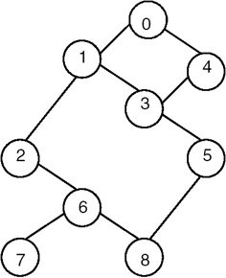
Graph
A graph data structure consists of a finite (and possibly mutable) set of nodes or vertices, together with a set of ordered pairs of these nodes (or, in some cases, a set of unordered pairs)

Slide 27
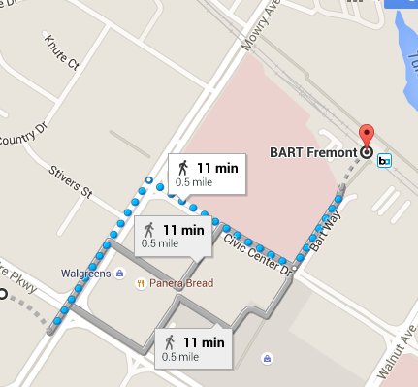
Example

Slide 28
Collection Framework
Collection framework is a implementations for the data structure and algorithms.
API for built-in data structures.
It contains Interfaces, Implementations(classes) and Algorithms(methods).

Slide 29
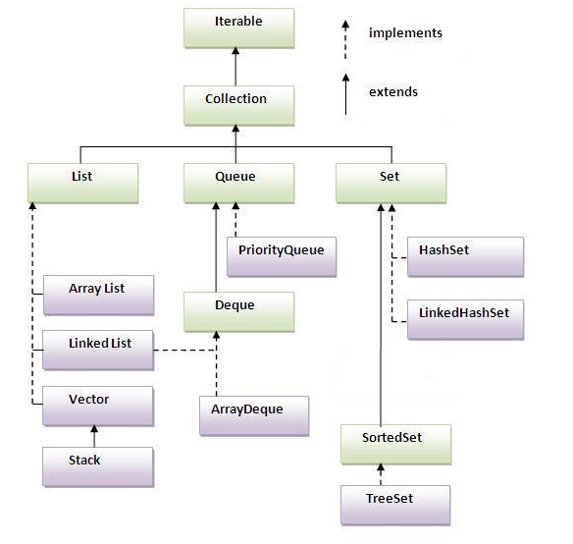
The Java Collection Framework
Notes:
List al = new ArrayList();
List ll = new LinkedList();
Set hs = new HashSet();
Map hm = new HashMap();
Set<Integer> set = new HashSet<Integer>();
TreeSet sortedSet = new TreeSet<Integer>(set);
SortedSet set = new TreeSet();

Slide 30
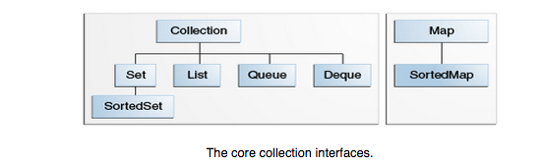
Summary of all interfaces in the java Collection

Slide 31
Summary of all interfaces in the java Collection
Collection
A group of objects.
May or may not be ordered
May or may not contain duplicates.
Set
The familiar set abstraction.
No duplicates
May or may not be ordered.
SortedSet
elements automatically sorted, either in their natural ordering (see the Comparable interface), or by a Comparator object provided when a SortedSet instance is created.

Slide 32
Cont..
List
Ordered collection, also known as a sequence.
Duplicates permitted
Allows positional access.
Map
A mapping from keys to values.
Each key can map to at most one value.
SortedMap
A map whose mappings are automatically sorted by key, either in the keys' natural ordering or by a comparator provided when a SortedMap instance is created.

Slide 33
classes of the java collection
AbstractCollection (Collection) →
AbstractSet (Set) → HashSet, TreeSet(SortedSet)
AbstractList (List) →ArrayList,
AbstractSequentialList → LinkedList
AbstractMap (Map) →
HashMap
TreeMap (SortedMap)
WeakHashMap
Arrays
Collections

Slide 34
General-Purpose Implementation classes
The primary implementations of the collection interfaces.
HashSet: Hash table implementation of the Set interface.
TreeSet: Red-black tree implementation of the SortedSet interface.
ArrayList: Resizable-array implementation of the List interface.
(Essentially an unsynchronized Vector.) The best all-around implementation of the List interface.

Slide 35
General-Purpose Implementation classes
LinkedList : Doubly-linked list implementation of the List interface.
May provide better performance than the ArrayList implementation if elements are frequently inserted or deleted within the list.
Useful for queues and double-ended queues (deques).
HashMap : Hash table implementation of the Map interface.
(Essentially an unsynchronized Hashtable that supports null keys and values.) The best all-around implementation of the Map interface.
TreeMap : Red-black tree implementation of the SortedMap interface.

Slide 36
LinkedList
The LinkedList class extends AbstractSequentialList and implements the List interface. It provides a linked-list data structure
add(Object) : add element at end
get(index) : Returns the element at the specified position in this list.
remove(index) : Removes the element at the specified position in this list.
size() : Returns the number of elements in this list.
Notes:
LinkedList ll = new LinkedList();

Slide 37
ArrayList
ArrayList class extends AbstractList and implements the List interface. ArrayList supports dynamic arrays that can grow as needed.
add(Object) : add element at end
get(index) : Returns the element at the specified position in this list.
remove(index) : Removes the element at the specified position in this list.
size() : Returns the number of elements in this list.
Notes:
ArrayList al = new ArrayList();
Add -> one element
Iterator -> convert into iterator
addAll -> one more arraylist
removeAll -> remove another arraylist
retainAll -> intersection between arraylist

Slide 38
HashSet
HashSet extends AbstractSet and implements the Set interface. It creates a collection that uses a hash table for storage.
A hash table stores information by using a mechanism called hashing. In hashing, the informational content of a key is used to determine a unique value, called its hash code.
add(Object) : add element at end
remove(index) : Removes the element at the specified position in this list.
size() : Returns the number of elements in this list.
Notes:
HashSet hs = new HashSet();

Slide 39
LinkedHashSet
class extends HashSet, but adds no members of its own.
LinkedHashSet maintains a linked list of the entries in the set, in the order in which they were inserted.
The hash code is then used as the index at which the data associated with the key is stored.
The transformation of the key into its hash code is performed automatically.
Notes:
LinkedHashSet lhs = new LinkedHashSet();

Slide 40
LinkedHashSet
class extends HashSet, but adds no members of its own.
LinkedHashSet maintains a linked list of the entries in the set, in the order in which they were inserted.
The hash code is then used as the index at which the data associated with the key is stored.
The transformation of the key into its hash code is performed automatically.

Slide 41
Vector
Vector implements a dynamic array. It is similar to ArrayList, but Vector is synchronized.

Slide 42
Stack
Stack is a subclass of Vector that implements a standard last-in, first-out stack.

Slide 43
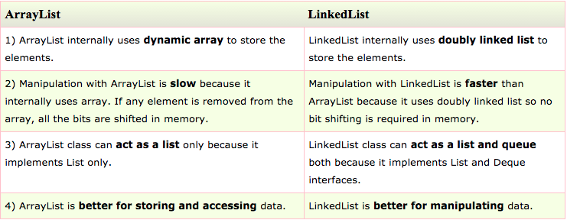
ArrayList Vs LinkedList
Notes:
ArrayList al = new ArrayList();
Add -> one element
Iterator -> convert into iterator
addAll -> one more arraylist
removeAll -> remove another arraylist
retainAll -> intersection between arraylist

Slide 44
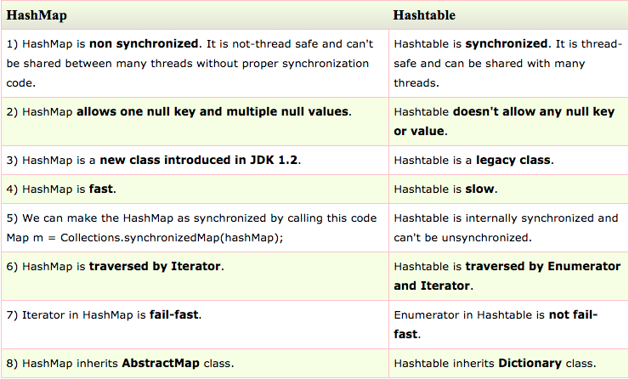
Hash Map vs Hash Table

Slide 45
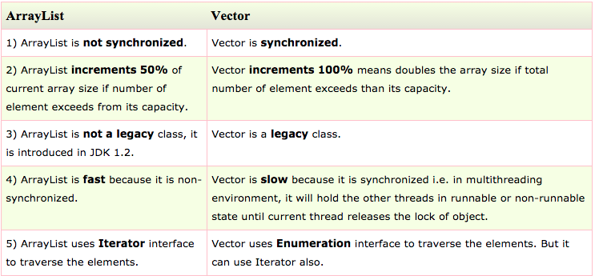
ArrayList vs Vector

Slide 46
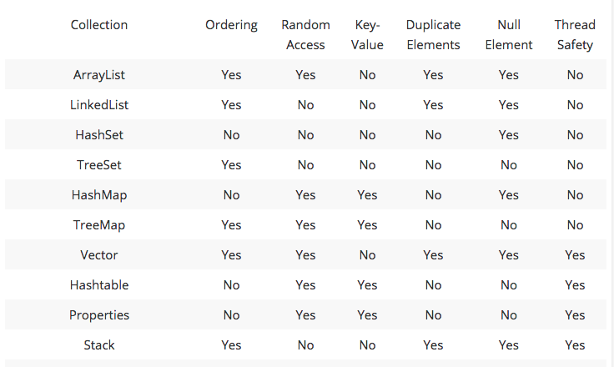
Collection Framework

Slide 47
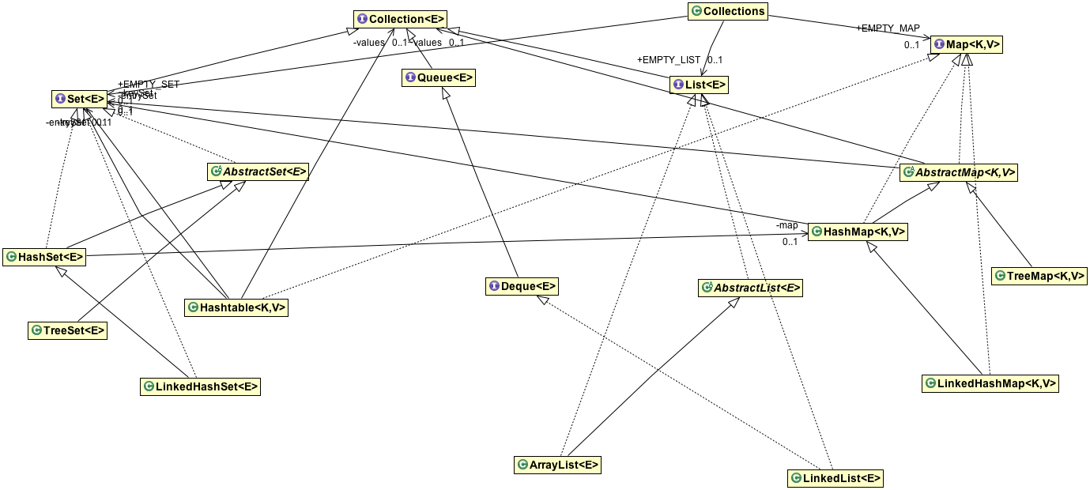
Collection Framework

